Slide 1

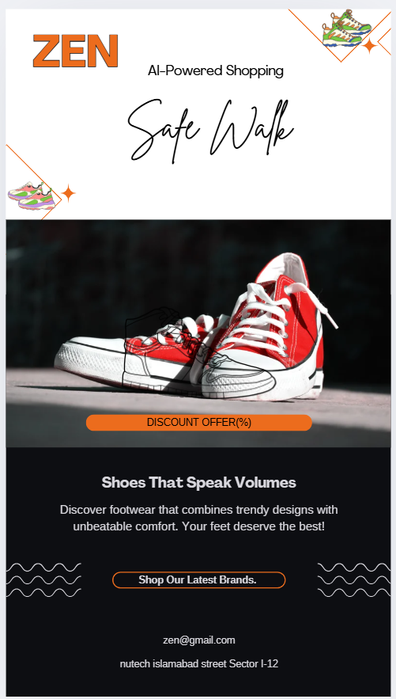
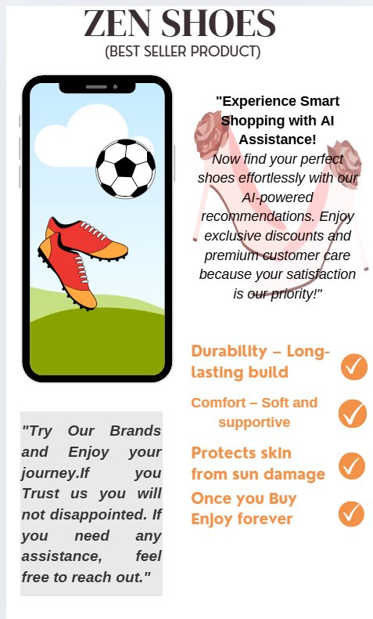
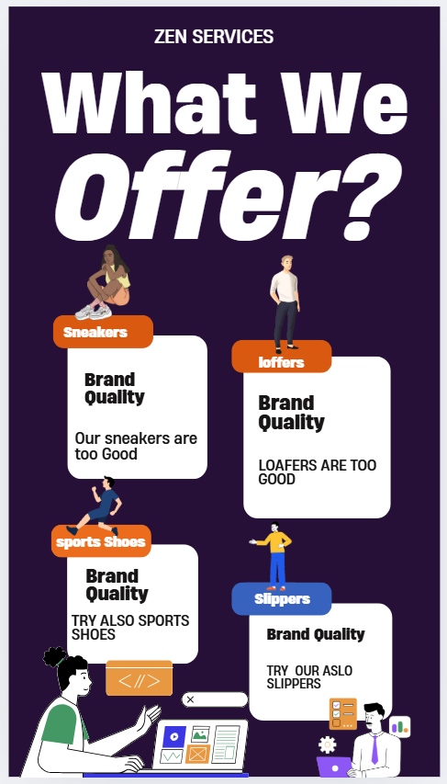
National University of Technology (NUTECH)
Computer Science Department
Project:
AI POWERED E-COMMERECE WEBSITE
Team Members:
M.Rehan Siddique
Inshal Rabbani
M.Anas
Ismail Shah
M.Moeen
Supervised by:
Tayyaba Kalsoom
Main Objective:
To enhance the online shopping experience by integrating AI-powered features such as a chatbot, personalized recommendations, and making it easier for users to find and purchase the perfect shoes.
Key Features
Core Website Features:
Dynamic Product Categories
Single Product Description Page
Shopping Cart System
Secure Checkout Process
User Authentication
Admin Panel Features:
Order Management
Payment Handling
AI Integration Features:
AI Chatbot for Customer Support
Chatbot Recommendations

